Slide 1
CDOT Update to the Bennett Town Board of Trustees
March 14, 2023

Slide 2
Presentation Overview
General CDOT information
I-70 & SH 79 Bridge Design/Loves Truck Parking
I-70 & SH 79 EB Off Ramp
Marketplace Dr. Signal Warrant
SH 79 Access Control Plan
CDOT R1 Bike/Ped Safety Study
Speed Limit adjustments through town
Exit 305 Kiowa-Bennett bridge
Kiowa Bennett Trail
SH-79 Bypass

Slide 3
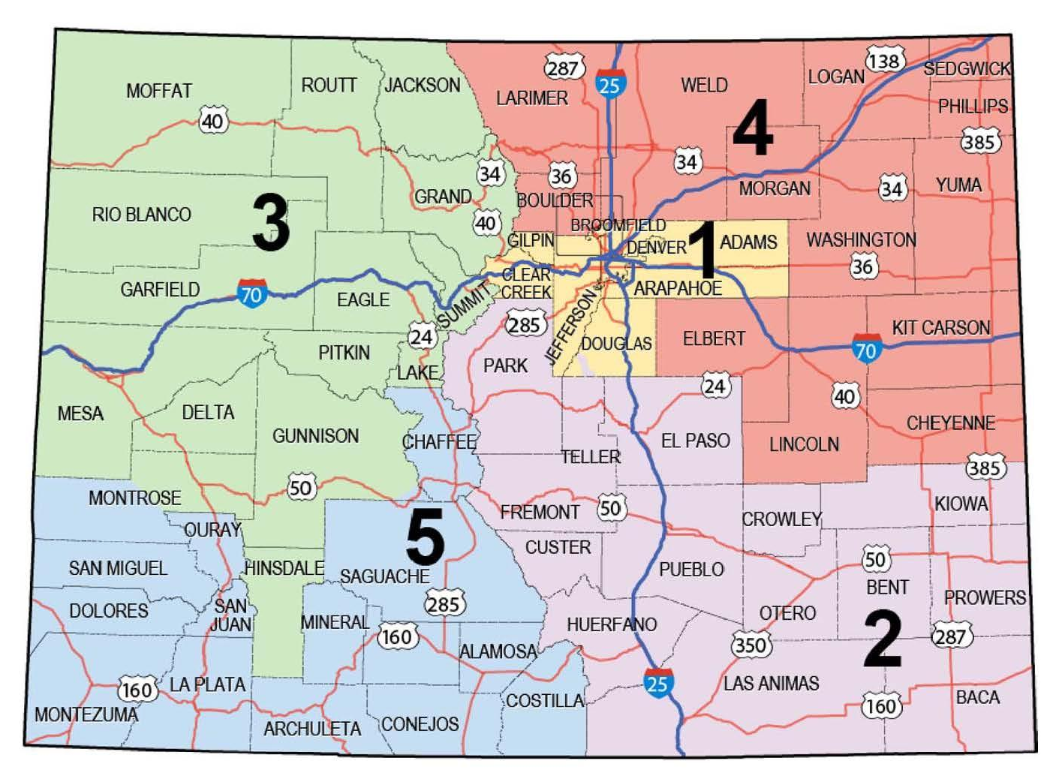
CDOT Regions

Slide 4
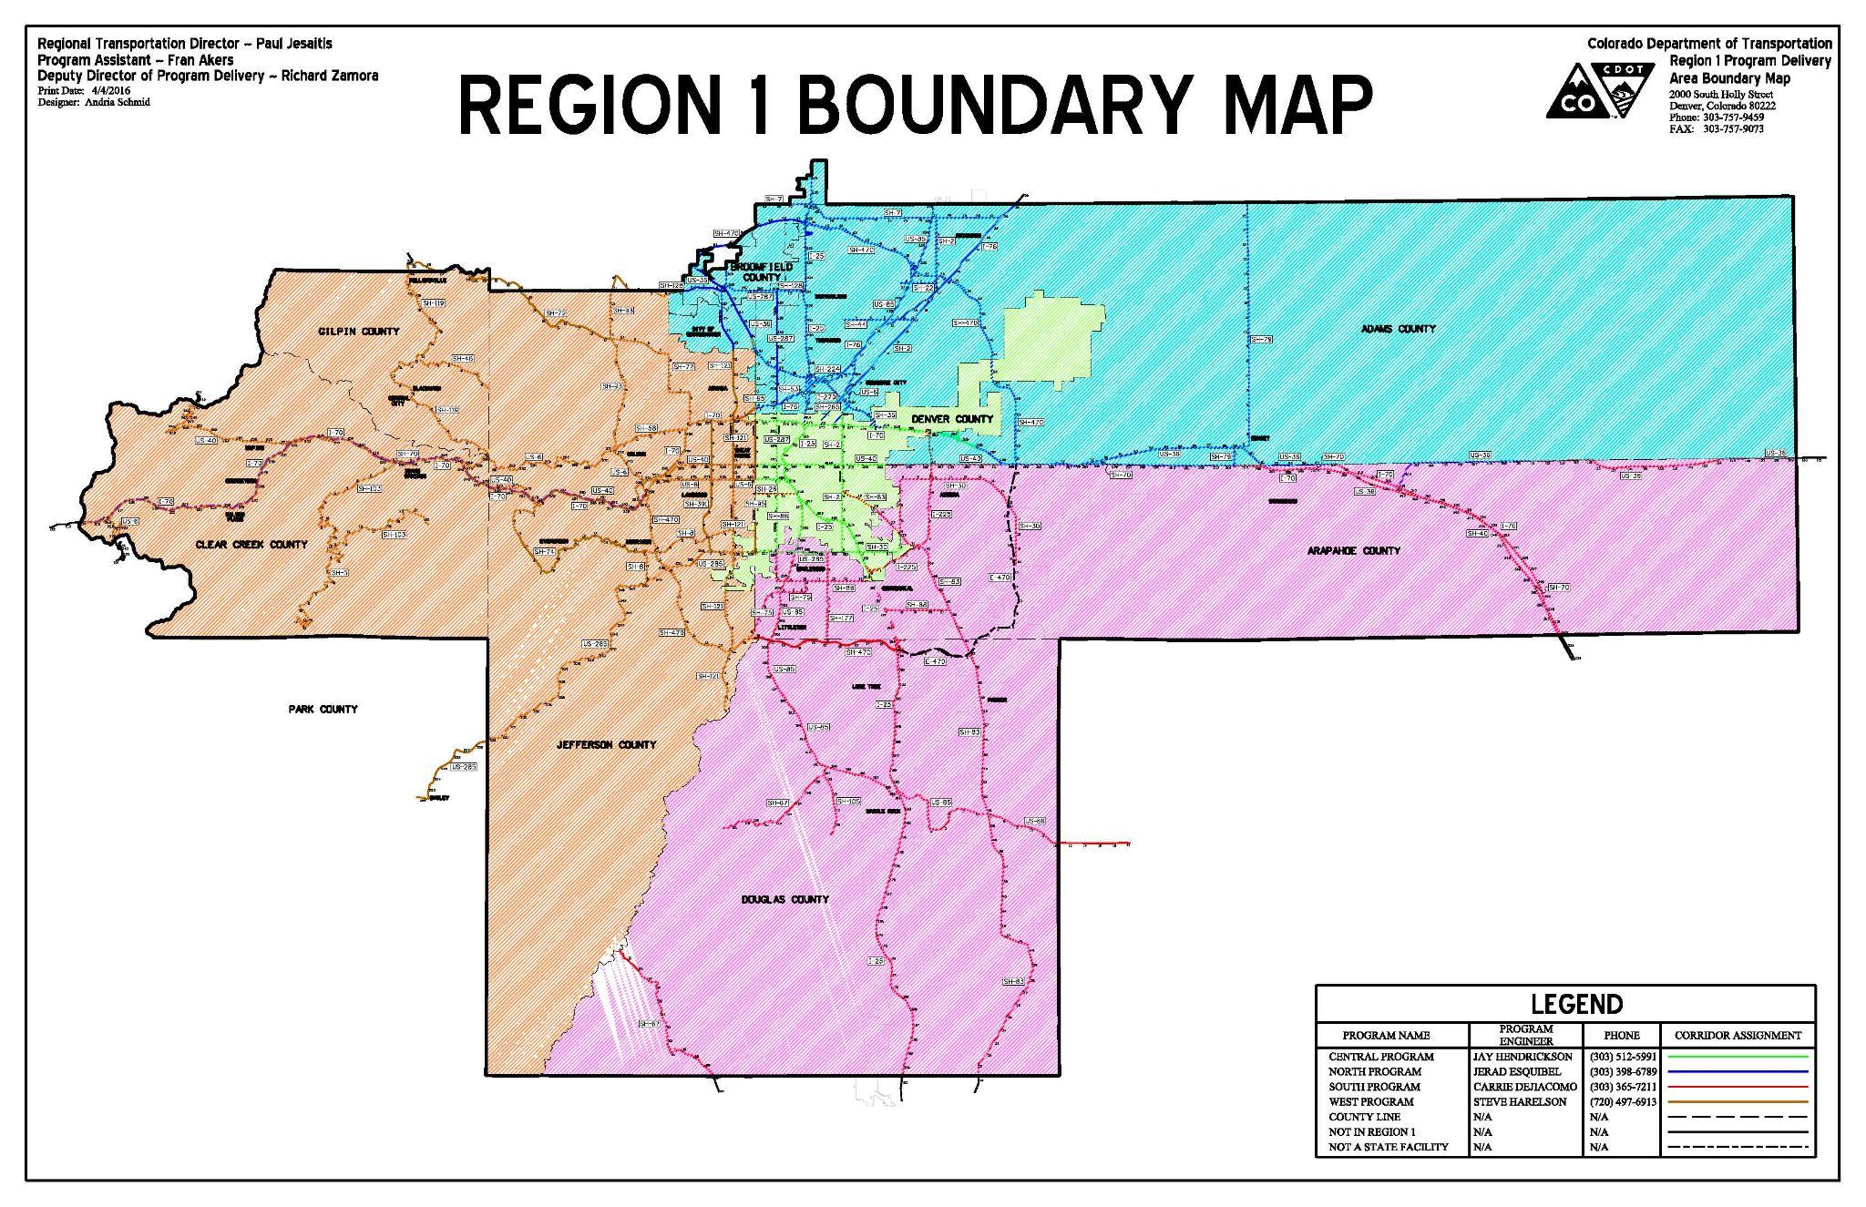
Region 1 Program Areas
Notes:
Region 1 is broken up into North, South and West Programs

Slide 5
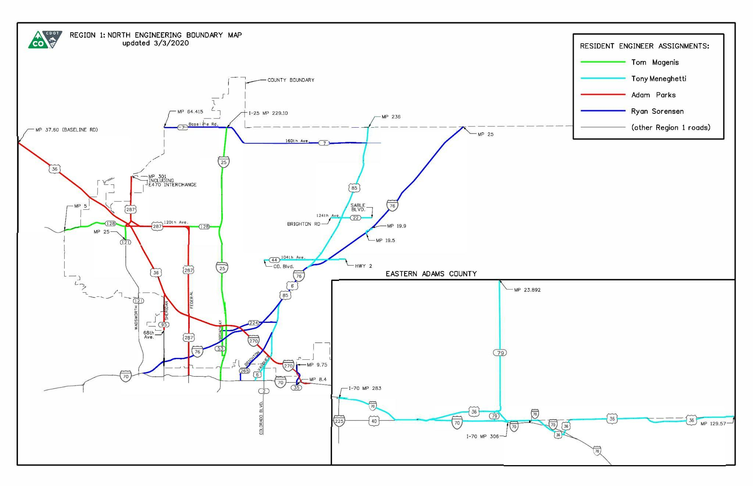
Region 1 North Program -Residencies
Notes:
North Program is broken up into 4 Engineering Residencies.
Tom Magenis - I-25 Metro;
Me-Platte Valley Residency - I-70 to Byers, SH 79 north of I-70 to MP 23.892, US 36 out to MP 129.57 (Washington County Line)
Adam Parks - Turnpike Residency;
Gary Huber (acting) - I-76 Residency

Slide 6
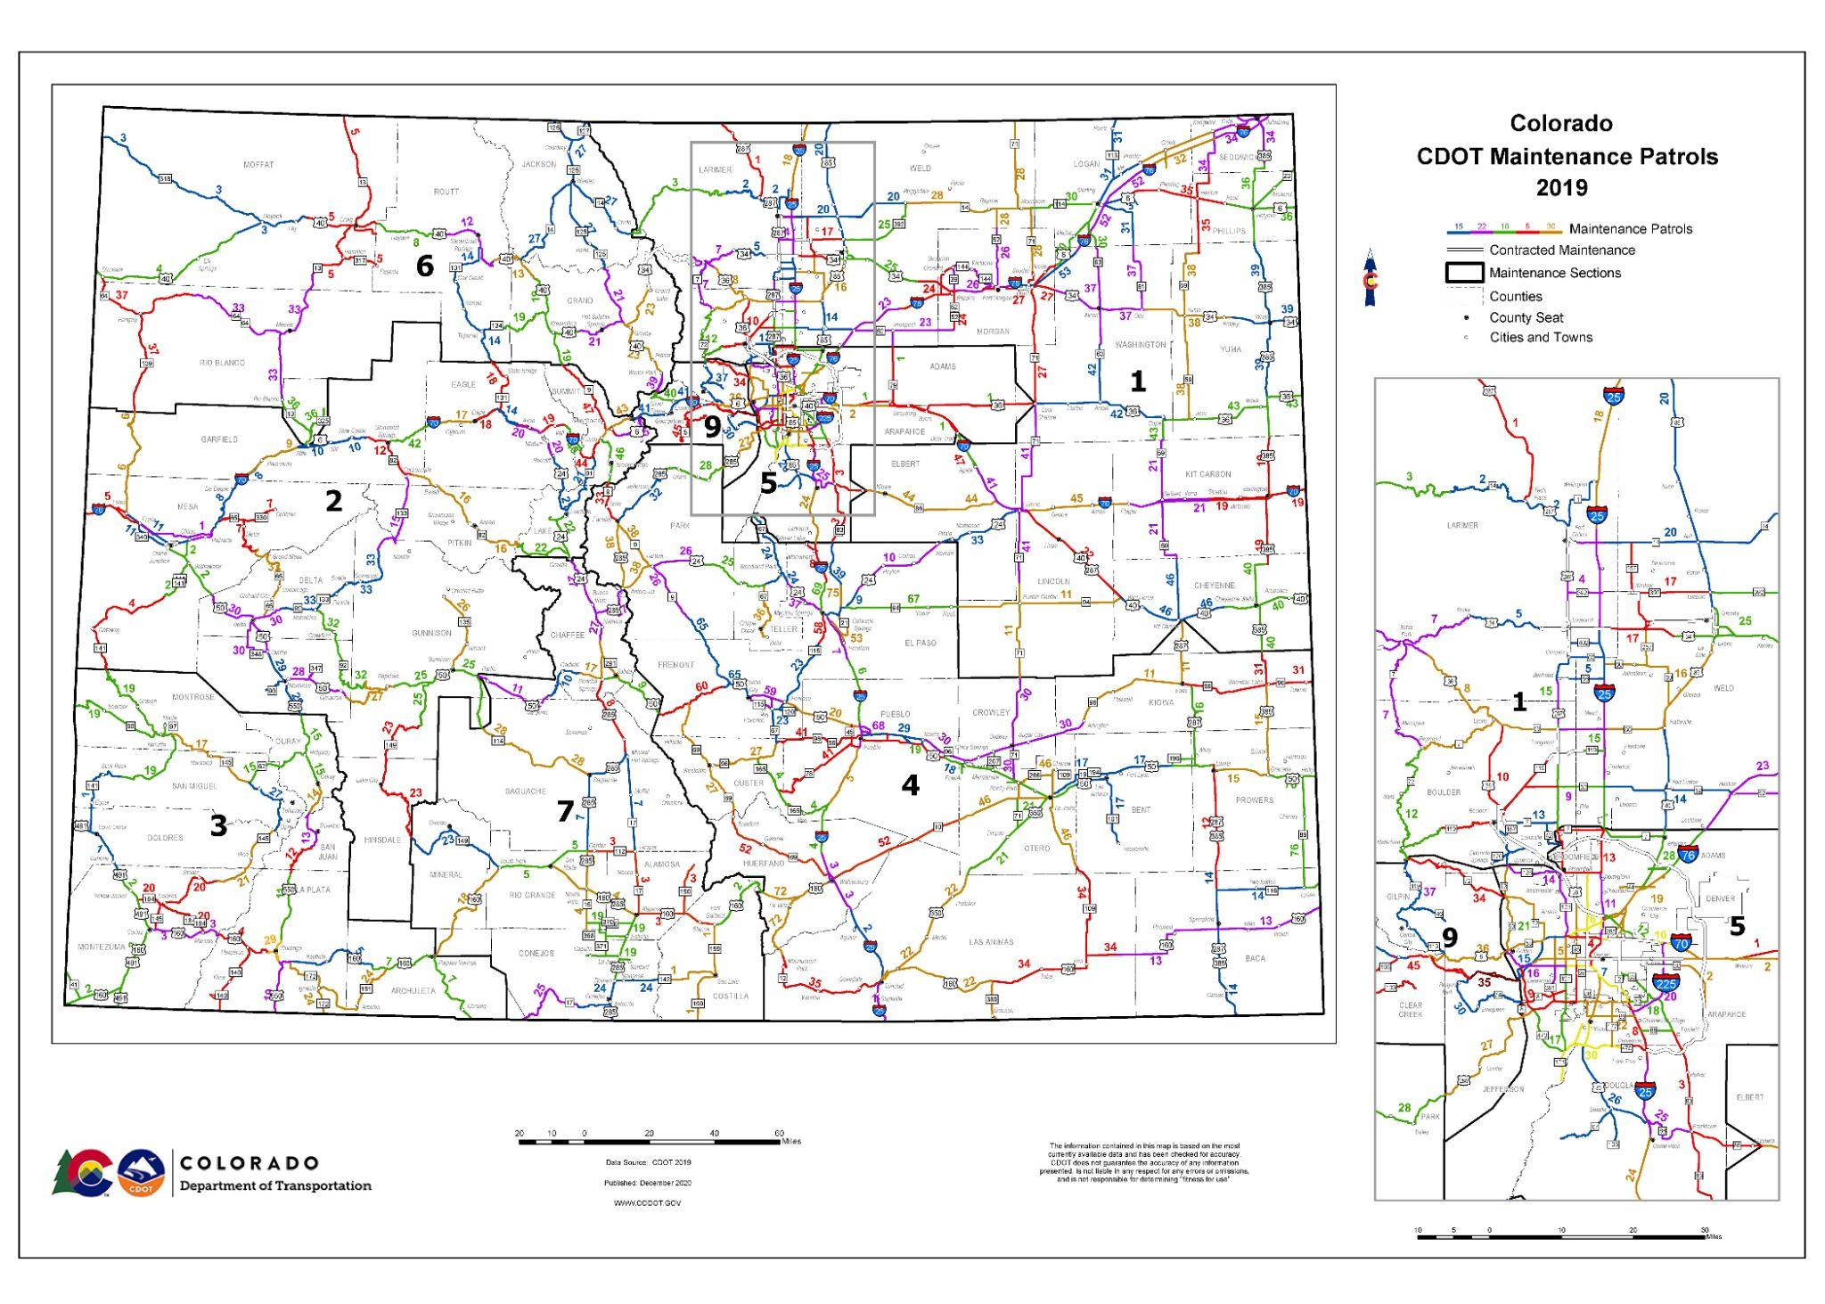
CDOT Maintenance Patrols
Notes:
CDOT Engineering and CDOT Maintenance are separate divisions. CDOT Maintenance is divided up into patrols. CDOT Region 1 is Patrol 5 and Patrol 9

Slide 7
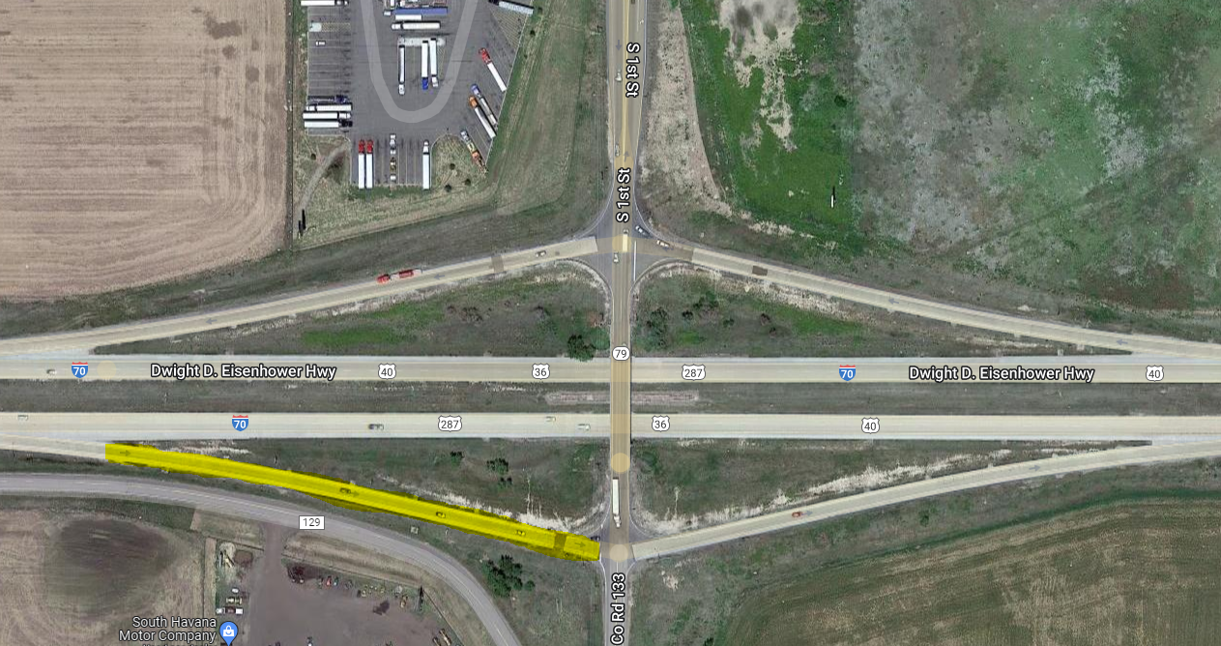
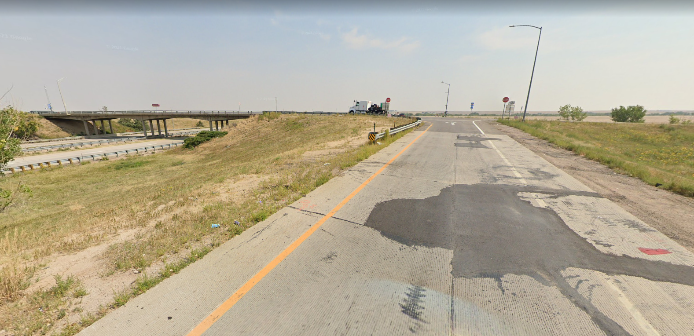
I-70 & SH 79 EB Off Ramp
Local Agency Project
Project was re-advertised on February 13th
Mandatory pre-bid meeting was held on February 21st
4 contractors in attendance
Bids due on March 15th
Bid opening on March 16th
Anticipated notification of award on March 20th
Notes:
Local Agency - Refers to a public agency, publicly owned organization or private interest group that enters into an agreement with CDOT for a transportation project.
Three types of projects: 1) CDOT Lead, 2) Local Agency, 3) Permit/Access Project
CDOT Local Agency Manual - can assist Local Agency personnel involved in the design, construction and management of State and Federally funded projects

Slide 8
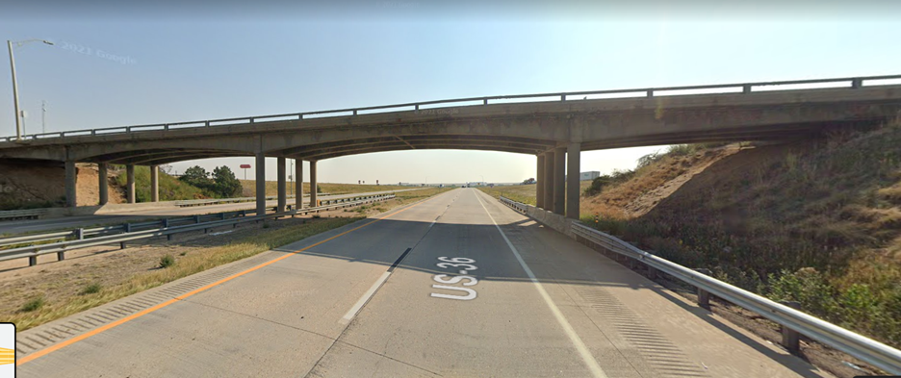
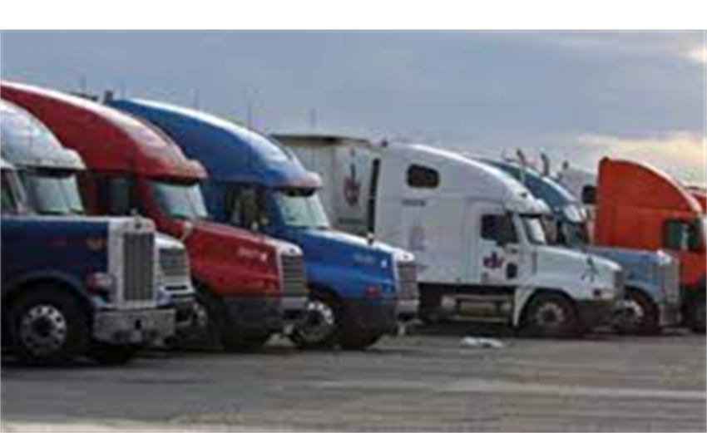
I-70 & SH 79 Bridge, Loves Truck Parking
CDOT project through partnership with the Town of Bennett and Love’s
$2 million in design funding
Theorem was selected as the design consultant
Kickoff meeting was held on 11/1/22
Preliminary design is underway
Traffic analysis complete
SUE (Subsurface Utility Exploration) is complete
Survey to be delivered this week
Shelf plans expected to be completed in February 2024

Slide 9
I-70 & SH 79 Bridge, Loves Truck Parking
Construction funding TBD
Met with CDOT Grants Specialists - There will be multiple grant opportunities for the Town of Bennett to apply for:
MEGA/INFRA
Bridge Investment Program

Slide 10
Marketplace Dr. Improvement, Signal & Warrant
Majority of the geometric improvements at Marketplace have been completed. Some additional work and final paving remains.
While the traffic study was ongoing, CDOT agreed that the signal poles could be installed prior to warrants. (Just the poles and conduits and no mast arms will be installed at this time until the signals have met their warrants.)
A traffic signal warrant study has been completed by the Town of Bennett to establish justification for a traffic signal at Marketplace. The study has been submitted to CDOT for review.
Typical CDOT review time is 1-2 weeks.

Slide 11
CDOT R1 Bike/Ped Safety Study
Bike/Ped Improvement Implementation - CDOT is working on a task order for completion of the Plans, Specifications & Estimate (PS&E) package at E. Colfax Ave. at Adams St. and 1st Street at Centennial Dr.
CDOT Traffic is working on a design schedule and is meeting with speciality units to figure out what can be completed in-house so we can reduce design cost.

Slide 12
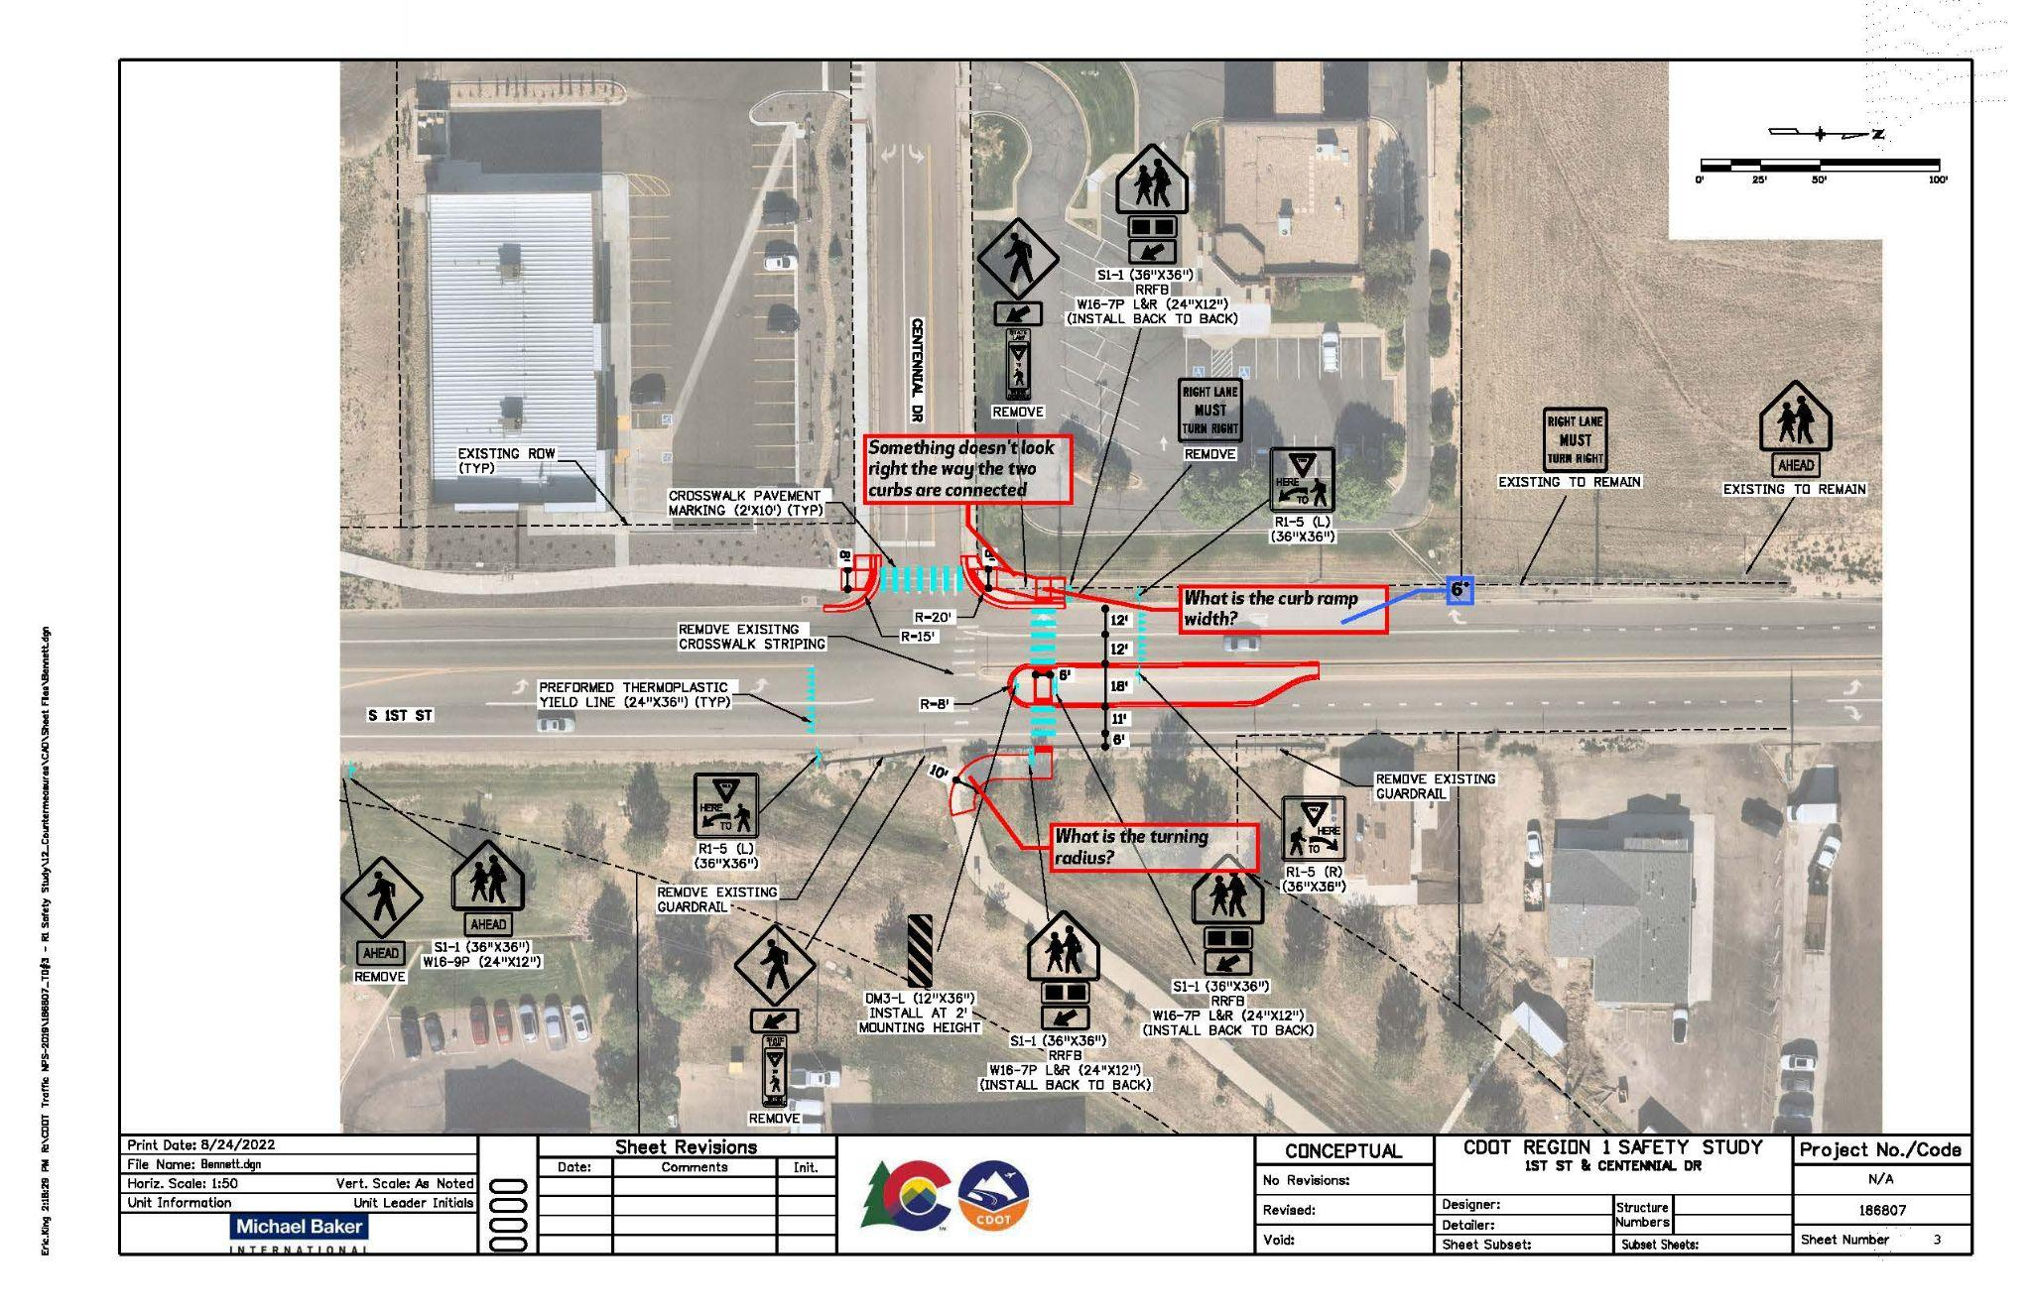
CDOT R1 Bike/Ped Safety Study: Centennial & 1st

Slide 13
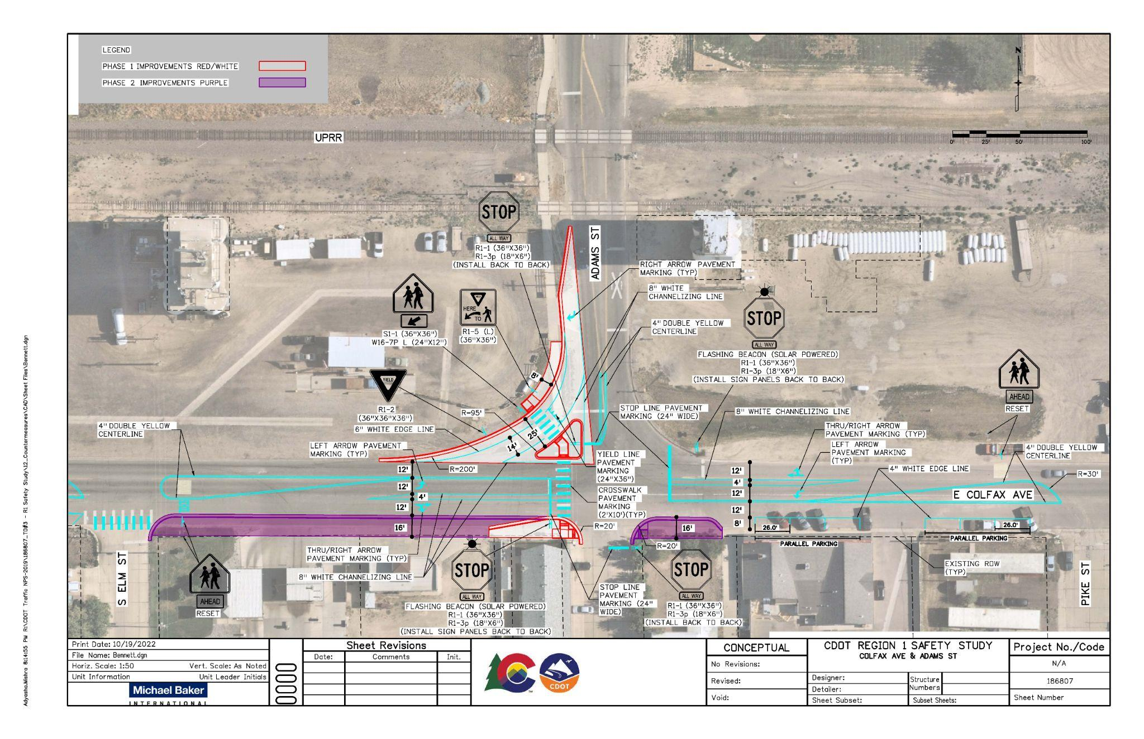
CDOT R1 Bike/Ped Safety Study: Colfax & Adams

Slide 14
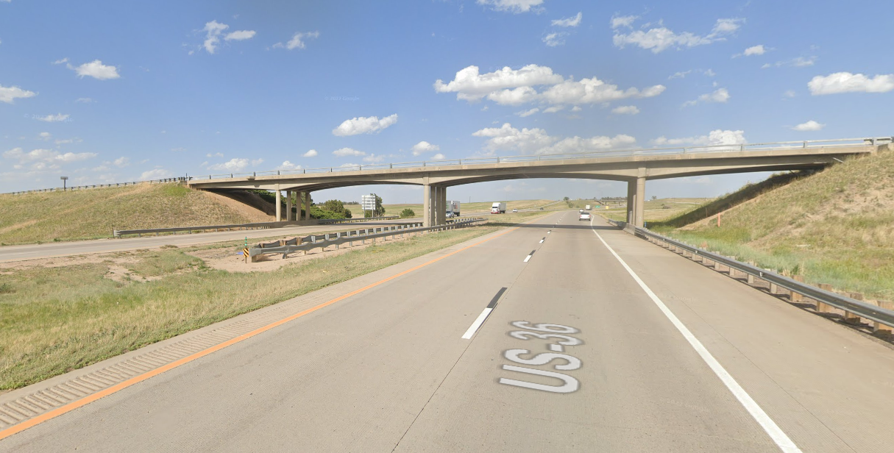
Exit 305 - Kiowa-Bennett Bridge
Bridge F-19-AF is a BTE eligible structure that is included in a R1 Bridge Prioritization Project that is actively progressing.
This project prioritizes Region 1’s structures that are in need of repair and replacement, while additionally working with the stakeholders and identifying strategic grant and funding opportunities.
CDOT and the project team will collaborate with the Town of Bennett structure F-19-AF throughout the project.

Slide 15
Other Partnering Projects
The Access Control Plan was signed 9-21-2022 and is now official.
Bennett Transportation Master Plan reviewed and comments provided in February.
Speed limit adjustment through Town
If the Town wants to request we will send them an agreement form and and the Town will agree that IF the study showed a change of a speed limit is needed, they would accept.

Slide 16
Other Partnering Projects
Kiowa Bennett Trail
Local Agency project
IGA is executed
Next steps:
Town of Bennett to put together RFP documents to procure a design consultant
Option letter to encumber design phase funds
SH-79 Bypass
30% plans were shelved in December 2020 - included both overpass and underpass options
No construction funding identified; potential for design-build
CDOT is on the lookout for potential funding opportunities

Slide 17
Questions?
Alazar Tesfaye, Region 1 Traffic Program Engineer
alazar.tesfaye@state.co.us
303-564-6446
Kirk Allen, Manager, Permits & Utilities Unit
kirk.allen@state.co.us
303-913-3084
Caroline Johnson, Project Manager
caroline.johnson@state.co.us
303.398.6749
Anthony Meneghetti, Resident Engineer, R1 North Program
anthony.meneghetti@state.co.us
303-827-6590
Notes:
What can we do to help?

